Slide 1


Escanaba and Lake Superior Railroad Intermodal Facility
Jake Dedering Travis Hamel Austin Kerby Zoe Wahr
1
Speaking: Jake Dedering

Slide 2
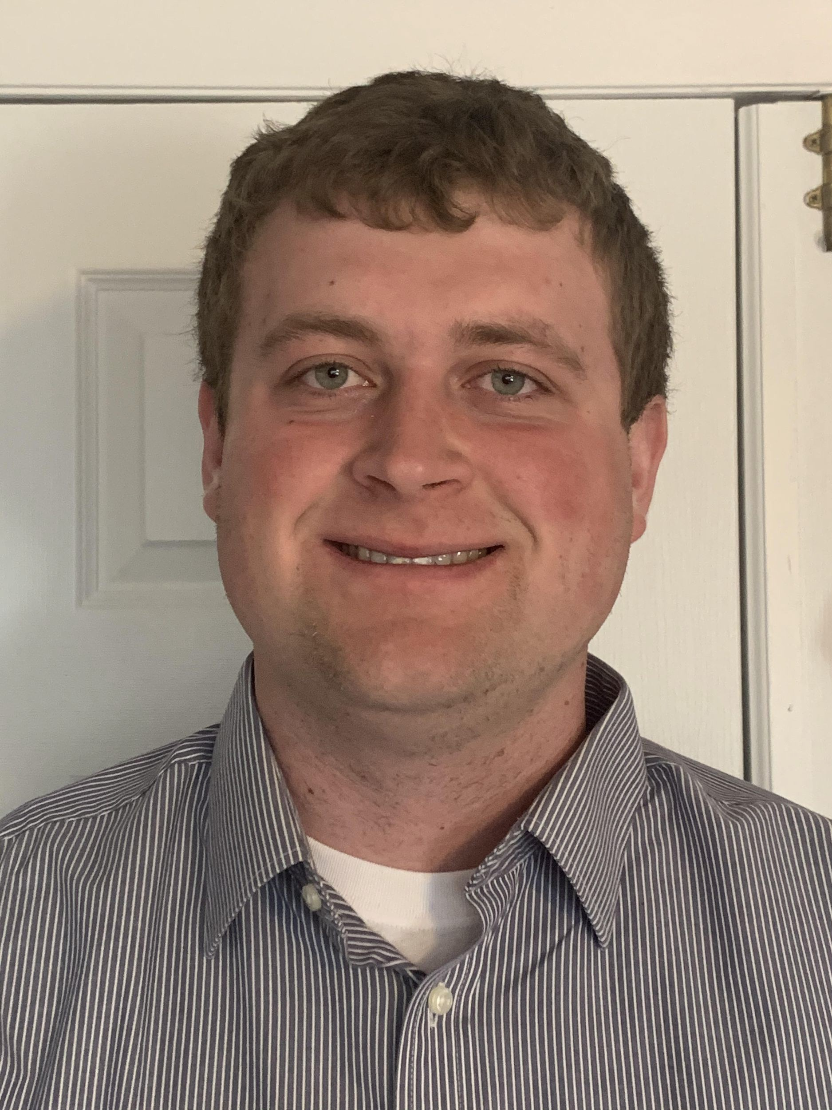
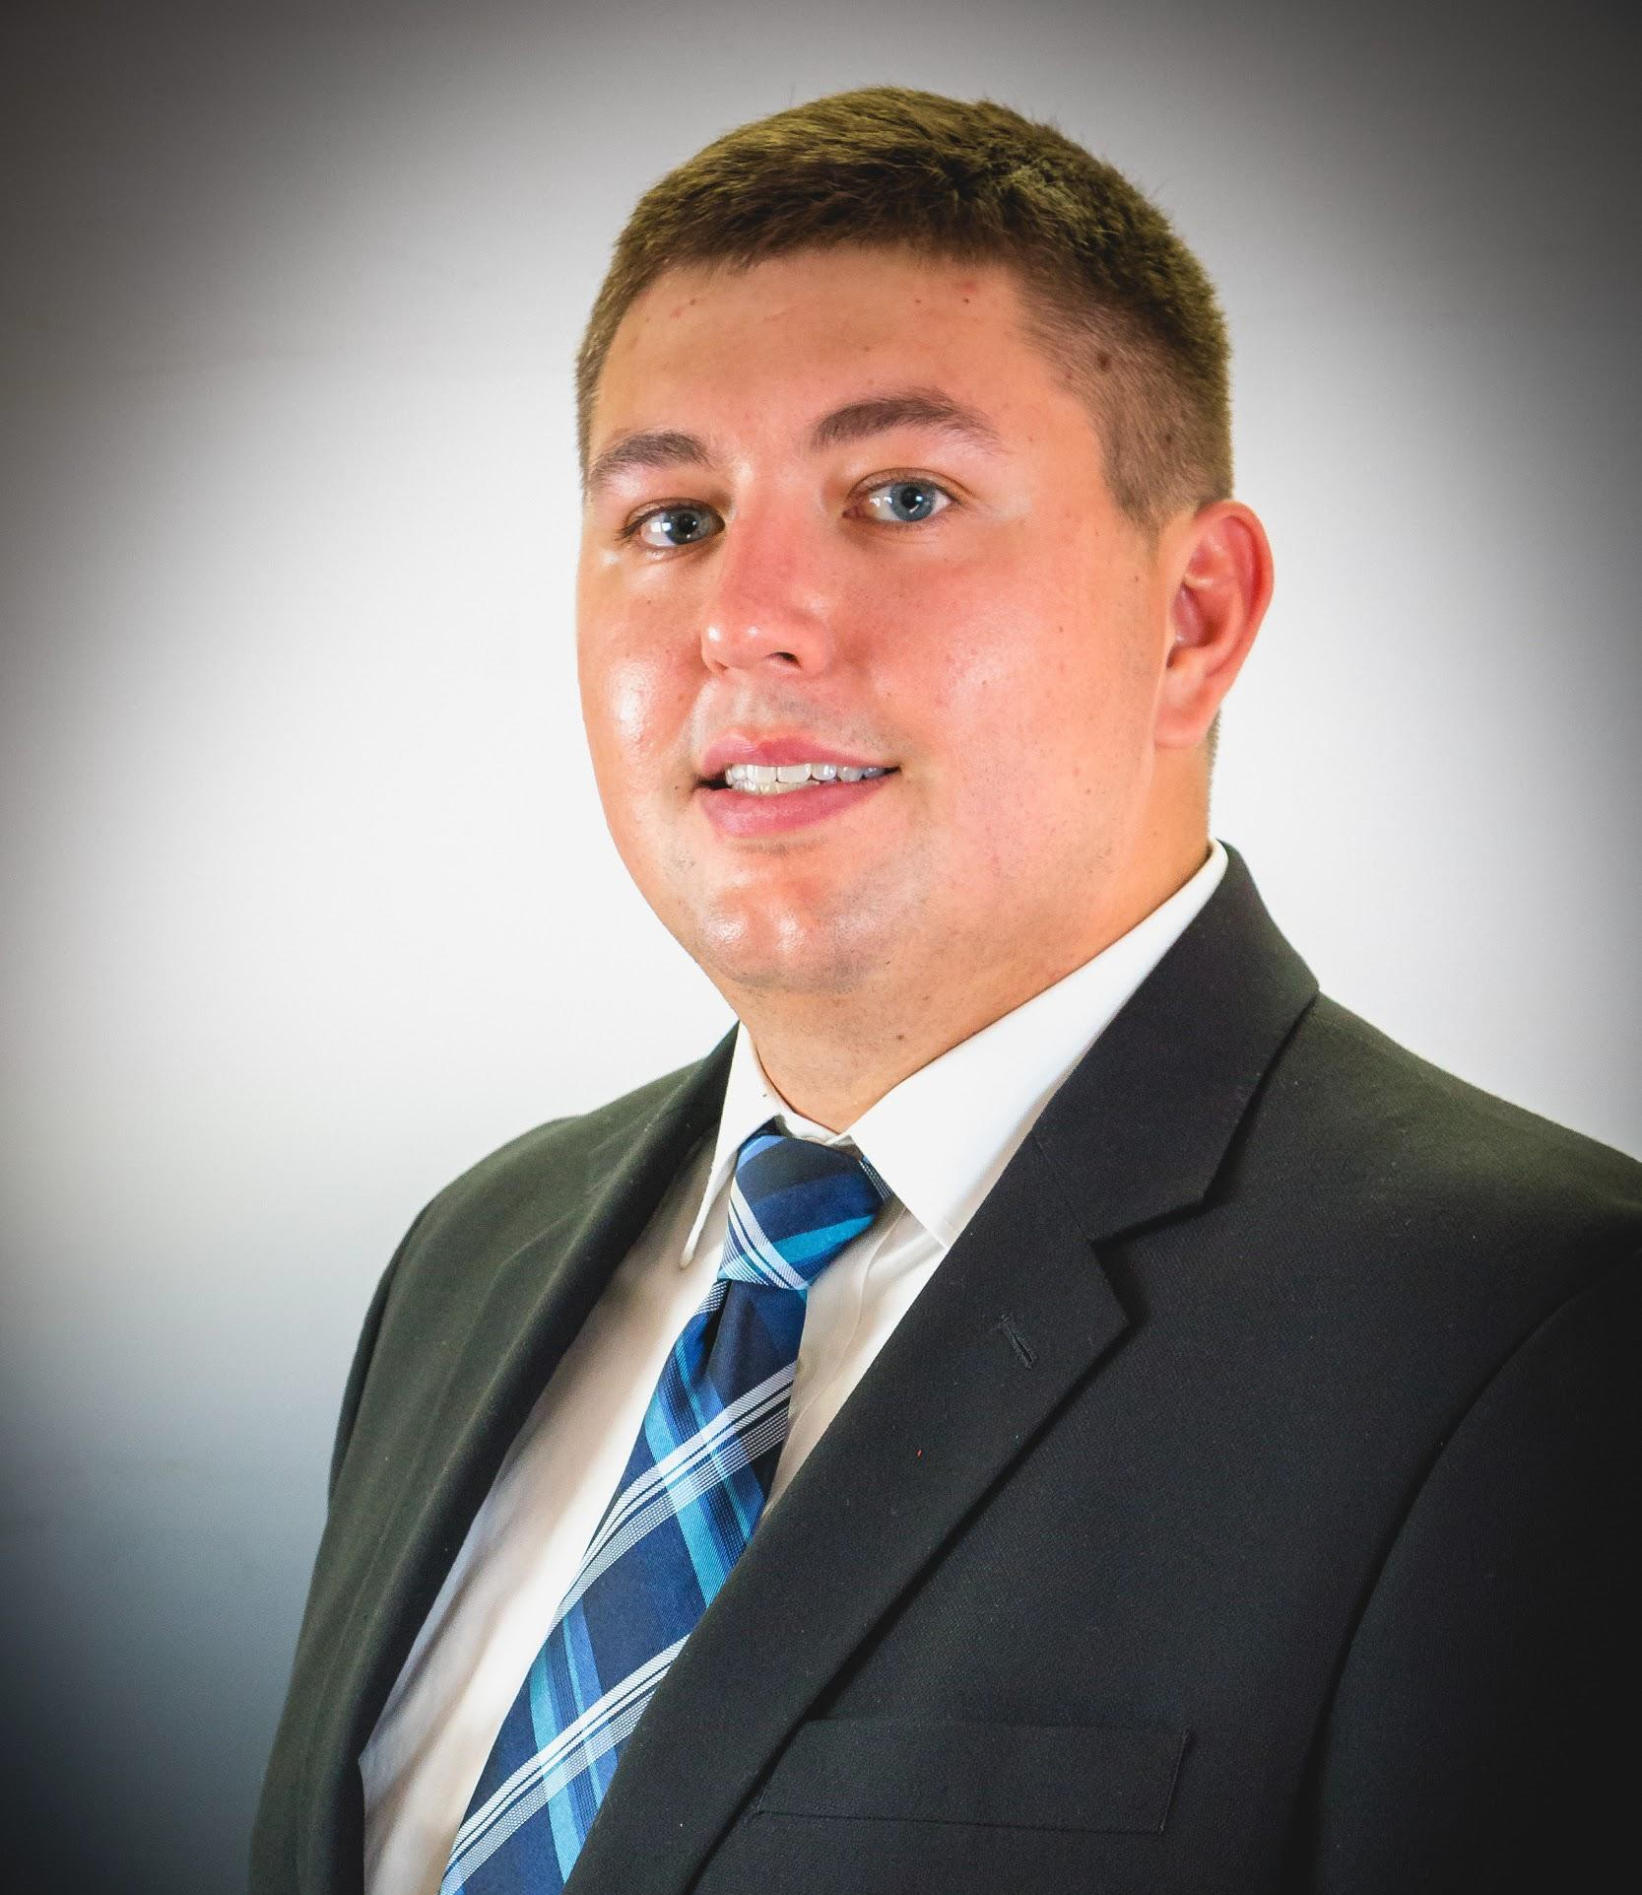
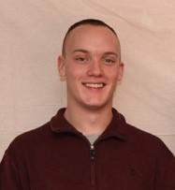
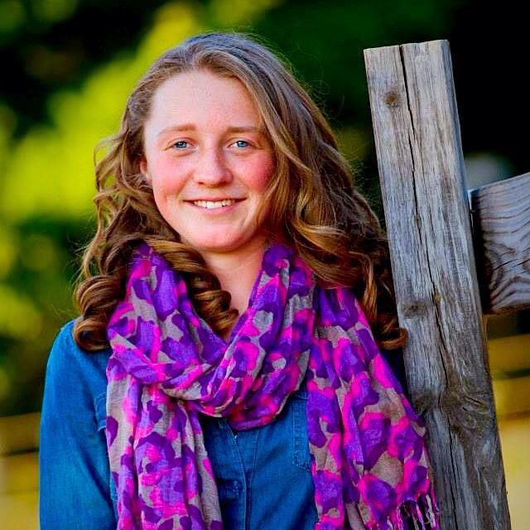
The Midwest Traﬃc Solutions Team
Jake Dedering Construction Scheduling Engineer
Travis Hamel Operations Engineer
Austin Kerby Cost Engineer
Zoe Wahr Project Manager Design Engineer
Speaking: Jake Dedering
2

Slide 3
Outline
Project Overview
Current Site Layout
Proposed Track Layout
Proposed Parking and Storage
Proposed Operation
Estimate
Construction Schedule
Site Equipment:
  Reach Stacker
  Oﬃce
Special Mentions
Speaking: Jake Dedering
2

Slide 4
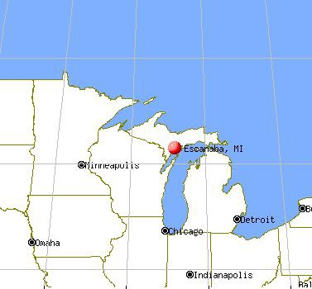
Project Overview
Escanaba, Michigan
Escanaba and Lake Superior Railroad (E&LS)
Developed Area
  Crane Manufacturing
  Nearby Businesses
Speaking: Jake Dedering
2

Slide 5
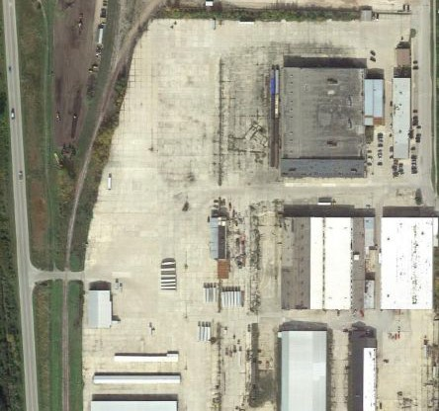
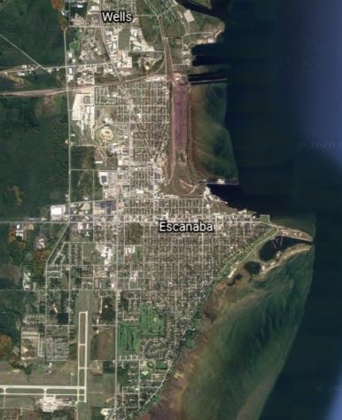
Current Site Layout
Speaking: Jake Dedering
2

Slide 6
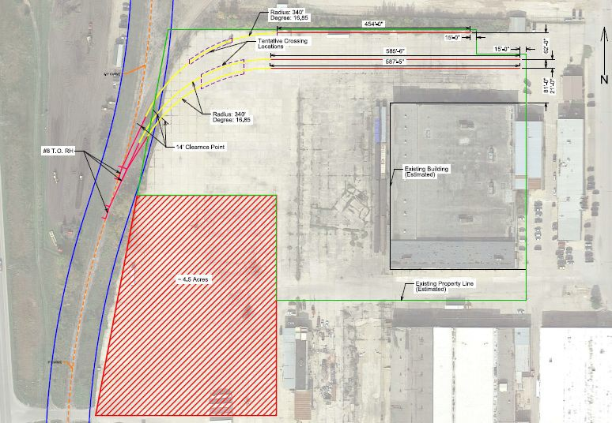
Proposed Track Layout
Proposed Track Proposed Land Purchase Proposed Curve in Track Proposed #8 Turnout
Proposed Crossing Location
Estimated Existing Property Line
Estimated Existing Track
Estimated Existing ROW
Estimated Building Location
Speaking: Zoe Wahr
Above: Screen capture of MicroStation design.

Slide 7
Proposed Track Layout
Proposed Track Proposed Land Purchase Proposed Curve in Track Proposed #8 Turnout
Proposed Crossing Location
Estimated Existing Property Line
Estimated Existing Track
Estimated Existing ROW
Estimated Building Location
Speaking: Zoe Wahr
Above: Screen capture of MicroStation design.

Slide 8
Proposed Track Layout
Proposed Track Proposed Land Purchase Proposed Curve in Track Proposed #8 Turnout
Proposed Crossing Location
Estimated Existing Property Line
Estimated Existing Track
Estimated Existing ROW
Estimated Building Location
Speaking: Zoe Wahr
Above: Screen capture of MicroStation design.

Slide 9
Proposed Track Layout
Proposed Track Proposed Land Purchase Proposed Curve in Track Proposed #8 Turnout
Proposed Crossing Location
Estimated Existing Property Line
Estimated Existing Track
Estimated Existing ROW
Estimated Building Location
Speaking: Zoe Wahr
Above: Screen capture of MicroStation design.

Slide 10
Proposed Track Layout
Proposed Track Proposed Land Purchase Proposed Curve in Track Proposed #8 Turnout
Proposed Crossing Location
Estimated Existing Property Line
Estimated Existing Track
Estimated Existing ROW
Estimated Building Location
Speaking: Zoe Wahr
Above: Screen capture of MicroStation design.

Slide 11
Proposed Track Layout
Proposed Track Proposed Land Purchase Proposed Curve in Track Proposed #8 Turnout
Proposed Crossing Location
Estimated Existing Property Line
Estimated Existing Track
Estimated Existing ROW
Estimated Building Location
Speaking: Zoe Wahr
Above: Screen capture of MicroStation design.

Slide 12
Proposed Track Layout
Proposed Track Proposed Land Purchase Proposed Curve in Track Proposed #8 Turnout
Proposed Crossing Location
Estimated Existing Property Line
Estimated Existing Track
Estimated Existing ROW
Estimated Building Location
Speaking: Zoe Wahr
Above: Screen capture of MicroStation design.

Slide 13
Proposed Track Layout
Proposed Track Proposed Land Purchase Proposed Curve in Track Proposed #8 Turnout
Proposed Crossing Location
Estimated Existing Property Line
Estimated Existing Track
Estimated Existing ROW
Estimated Building Location
Speaking: Zoe Wahr
Above: Screen capture of MicroStation design.

Slide 14
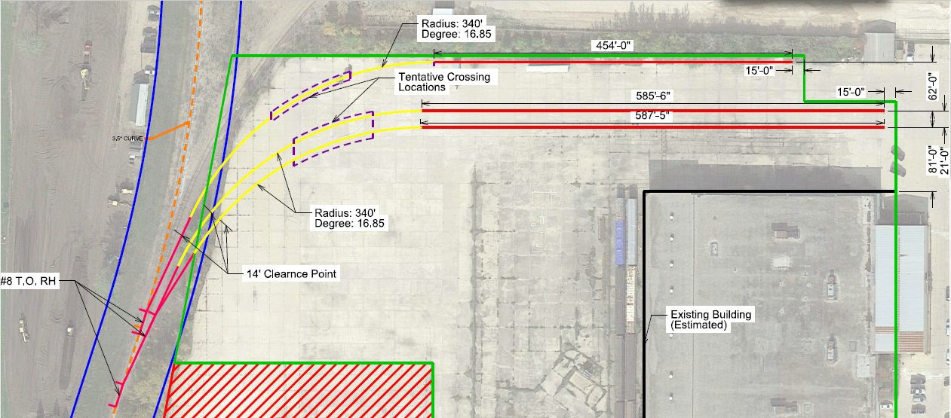
Proposed Track Layout
14
Speaking: Zoe Wahr
Above: Screen capture of MicroStation design with an emphasis on the track layout and measurements.

Slide 15
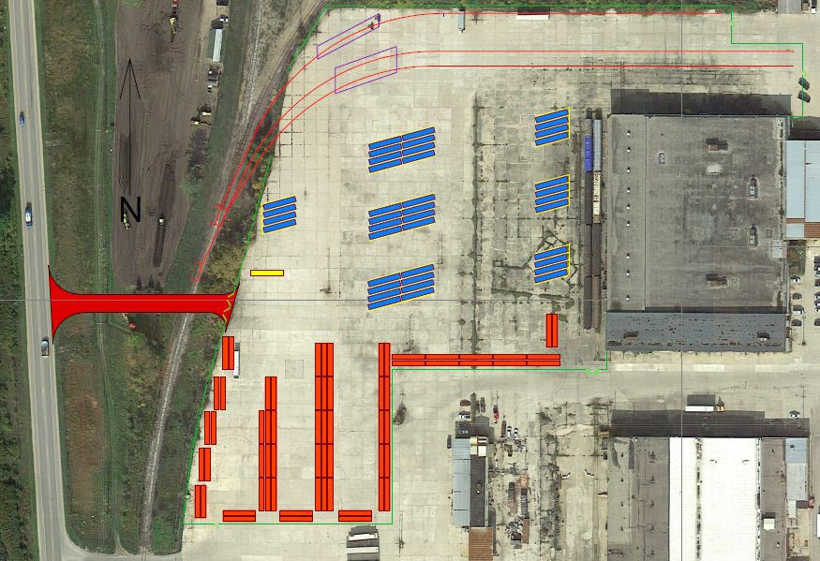
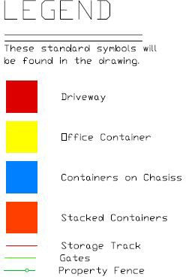
Proposed Parking and Storage Layout
Speaking: Travis Hamel
15

Slide 16
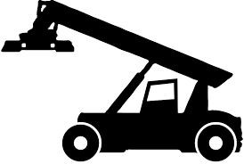
Storage Capacity
Single Side Access
Double Side Access
Optimum Capacity
156 containers on site
Combination of storage and eﬃciency
Maximum Capacity
320 containers on site
Low eﬃciency
16
Speaking: Travis Hamel

Slide 17
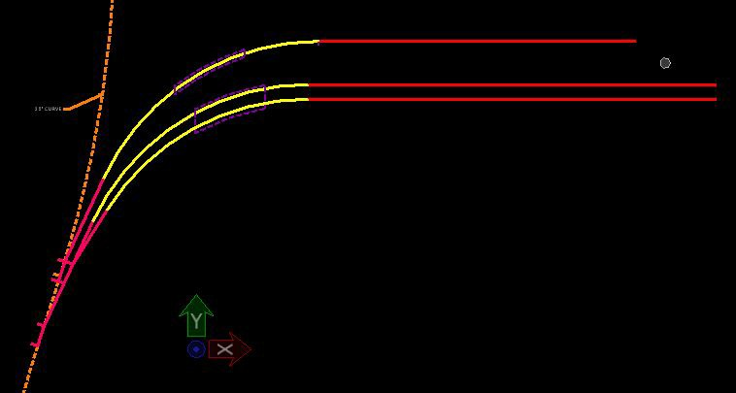
Proposed Operations
Engine Intermodal Car
Left: Screen capture of the track layout from MicroStation with ﬁgures added to represent the engine and intermodal cars.
The train enters the property from the North traveling South to deliver intermodal cars.
Speaking: Zoe Wahr

Slide 18
Proposed Operations
The train continues South until the last car is past the Southernmost #8 turnout in preparation of backing the train into the Southernmost working track.
Speaking: Zoe Wahr

Slide 19
Proposed Operations
The train continues South until the last car is past the Southernmost #8 turnout in preparation of backing the train into the Southernmost working track.
Speaking: Zoe Wahr

Slide 20
Proposed Operations
The train continues South until the last car is past the Southernmost #8 turnout in preparation of backing the train into the Southernmost working track.
Speaking: Zoe Wahr

Slide 21
Proposed Operations
The train then reverses into the Southernmost working track to detach X amount of cars.
This track allows for the easiest and quickest accessibility for the reach stacker, so it is likely this track will be used the most often.
Speaking: Zoe Wahr

Slide 22
Proposed Operations
The train should park the cars as far East as possible to reduce any congestion near the crossings, marked in purple hatching.
Speaking: Zoe Wahr

Slide 23
Proposed Operations
After the desired amount of cars are parked and detached from the train, the train will travel back to the mainline and past the middle turnout.
Speaking: Zoe Wahr

Slide 24
Proposed Operations
The train will then reverse onto the middle track and park X number of cars.
Speaking: Zoe Wahr

Slide 25
Proposed Operations
After the desired cars are parked and detached the train will again travel back to the mainline past the last turnout.
Speaking: Zoe Wahr

Slide 26
Proposed Operations
The remaining cars will then be backed onto the Northernmost track, parked and detached from the engine.
Speaking: Zoe Wahr

Slide 27
Proposed Operations
Given that this track is designed to hold 27 cars and the design train is only 20 cars long, the engine can safely park beyond the 14’ clearance point on the Northernmost track until needed.
The engine will then be used to remove the cars from the track and transport to the next destination.
Speaking: Zoe Wahr

Slide 28
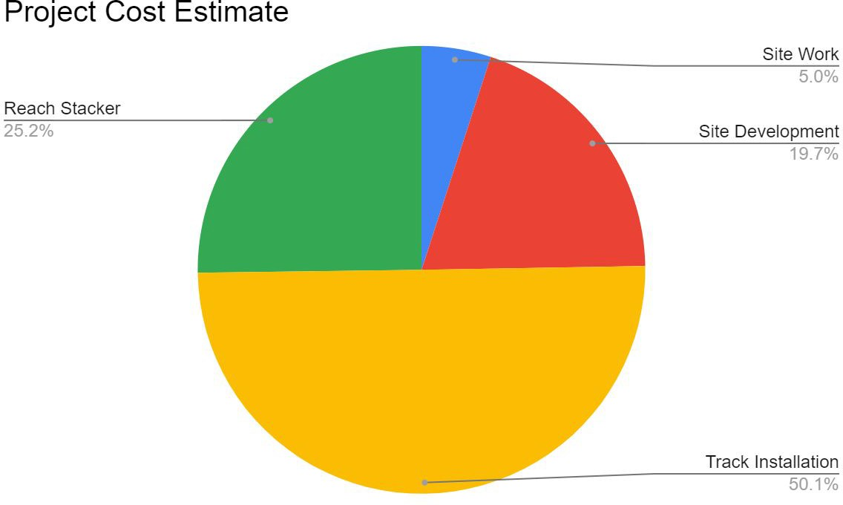
Estimate Summary:
Item: | Cost:
Site Work | $155,200
Track Installation | $1,551,400
Site Development | $610,800
Reach Stacker | $781,000
Subtotal: | $3,098,500
Overhead/Profit: | $837,500
Contingency: | $399,800
Total: | $3,984,000
Speaking: Austin Kerby
28

Slide 29
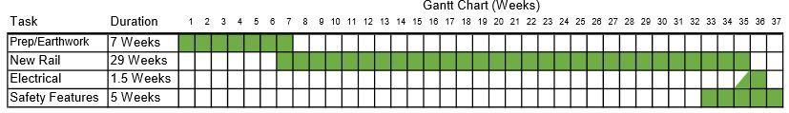
Construction Schedule
Estimated Start Date: April 5, 2021
Estimated Completion Date: December 13, 2021
Speaking: Jake Dedering
29

Slide 30
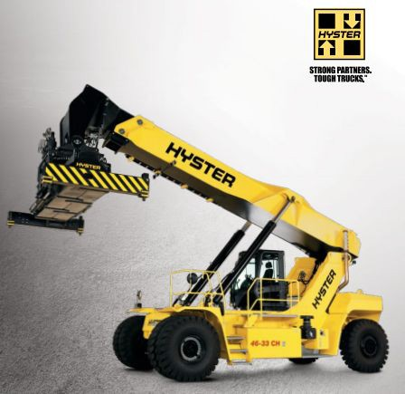
Reach Stacker
Hyster - Model RS46-41LS CH
First Row Load Capacity - 101,413 lbs
  Second Row - 90,390 lbs
  Third Row - 50,706 lbs
30’6” Outside Turning Radius
47’6” Stacking Height
Cost with tax - $781,000
  Quote with Fairchild Equipment
30
Speaking: Travis Hamel

Slide 31
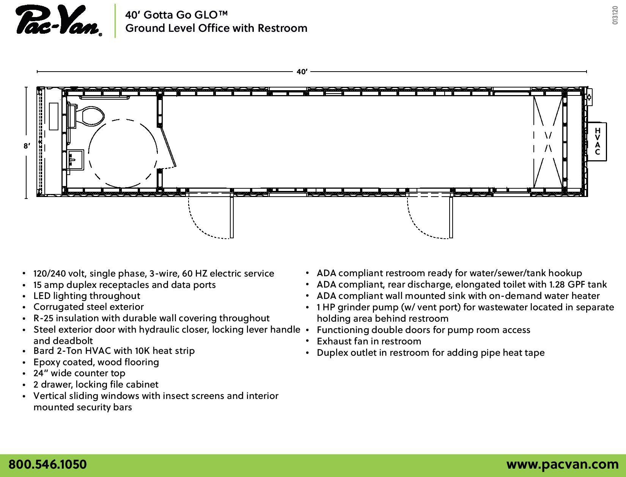
Oﬃce:
Required to obtain an oﬃce for checking in drivers at the site.
Oﬃce needed:
  Heat
  Electricity
  Bathroom with utility hookups
Speaking: Austin Kerby
31

Slide 32
Conclusions
Construction
1 season Design Train
20 Intermodal cars per train
4 - 5 trains per week
1 day turnaround per train Security
12’ High Fencing
Lighting equivalents 3 footcandles
Storage
Optimal: 156 containers
Maximum: 320 containers Parking
40 chassis
Cost: $3,984,000
32
Speaking: Austin Kerby

Slide 33
Special Mentions
Chris Desterheft - Pac-Van
Dan Block - Dynamic Design Group, Inc
David Nelson - Michigan Technological University
Jake Hiller - Michigan Technological University
Jason Campbell - Dynamic Design Group, Inc
Josh Kwiatkowski - Fairchild Equipment
Kris Mattila - Michigan Technological University
Mike Logan - Escanaba and Lake Superior Railroad
Pasi Lautala - Michigan Technological University
Terry Flower - City of Escanaba Engineering Oﬃce
Trey Rowland - Musco Lighting
Speaking: Travis Hamel
33

Slide 34
Questions?
34

